Slide 1

Presentation Name
DATE

Slide 2


Welcome, new hires!
NAME
Software Engineer, Teamname
NAME
Software Engineer, Team
More to come…

Slide 3


#Littlewins

Slide 4

Feature
Checklists
With
Elizabeth

Slide 5
Product Team Feature Checklist
The purpose of this checklist is to DO XYZ
STUFF
MORE STUFF

Slide 6

Automation
With
Person

Slide 7

Test Automation Suites
What about DoD?
Here and Now:
UI Automation Suites:
BC:
Nightly UI Regression
Local UI Sanity
BA:
Nightly UI Regression
Local UI Sanity
API Automation Suites:
BC:
Scheduled API Sanity
Local API Sanity
BA:
Scheduled API Sanity
Local API Sanity

Slide 8

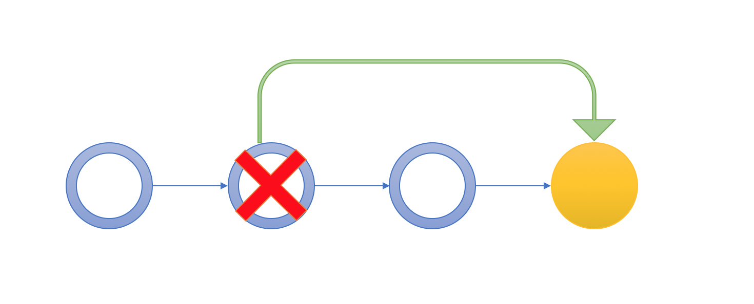
REVERTS

Slide 9
GIT-Revert
Allows the ability to revert one or more previous commits
Replaces the code you are reverting with the previous version
Applies the revert changes in a new commit

Slide 10
GIT-Revert

Slide 11
GIT-Revert – command line

Slide 12
GIT-Revert – Visual Studio

Slide 13
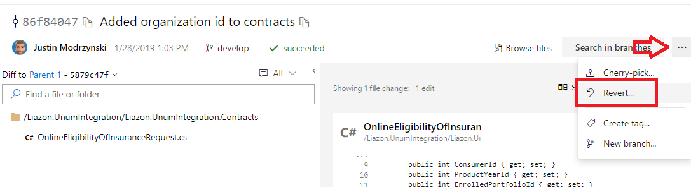
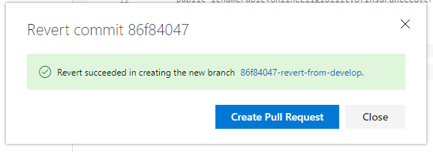
GIT-Revert – Azure Devops

Slide 14
REVERT
IS NOT
RESET

Slide 15

Impediment
Updates

Slide 16
History of our Impediments…

Slide 17
Dev branch status

Slide 18
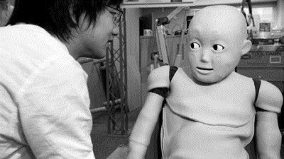
IMPEDIMENT BOT
Runs at 9am, noon, and 3pm
Impediments that hit 1, 4, 8, 16 hours old
Next up: BRANCH Locking, two-way chat

Slide 19

One more thing…

Slide 20

Questions?

